Slide 1
“EXPLORING DBMS WITH MS ACCESS”
Department: ELECTRICAL AND COMPUTER ENGINEERING
NAME: SYED SHAHIR
LAB INSTRUCTOR: SIR SHEHZAD RIZWAN
Subject: Database Systems (i)

Slide 2
PRESENTATION OUTCOMES
Know about the forms
Know about the relationships in DBMS
one -to -one relationship
one- to- many relationship
many-to-many relationship

Slide 3
Forms
A form in Access is a database object that you can use to create a user interface for a database application.
Putting data in tabular form
Putting data in tabular form via a user interface(GUI)
In simple words we may say that form is frontend while tabular datasheet is backend
Lets have a look at the example

Slide 4
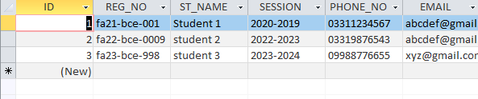
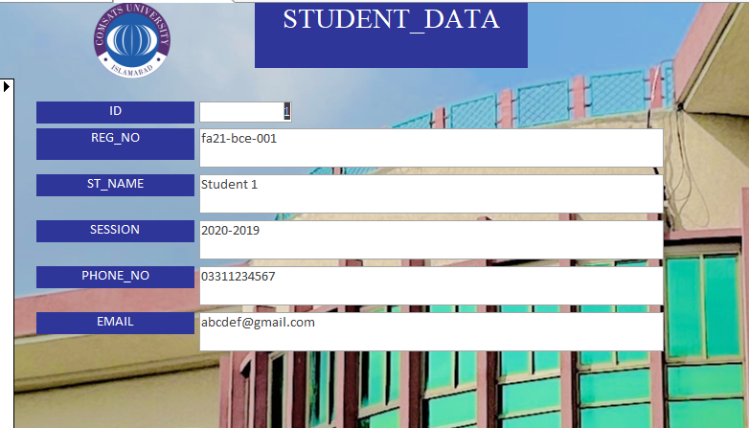

Slide 5
relationships
"Establishing Relationships" signifies the ability to define connections between different tables in your database
Relationships ensure data integrity and consistency by preventing the duplication of information and allowing for efficient data retrieval
By establishing relationships, you enable your database to manage complex data relationships effectively.
The most common 3 types of relationships are presented in the upcoming slides

Slide 6
TYPES OF KEYS
Before jumping into types lets understand keys
Primary key
A primary key is a field or combination of fields in a database table that uniquely identifies each record within that table.
Foreign key
A foreign key is a field in one table that is used to establish a link or relationship between that table and another table's primary key.

Slide 7
One-to-one relationship
A one-to-one (1:1) relationship in a relational database is a type of relationship between two tables where each record in the first table is directly associated with one and only one record in the second table, and vice versa
Lets have a look at the example

Slide 8
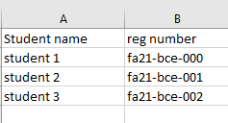

Example

Slide 9


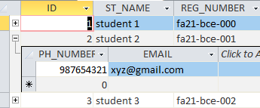
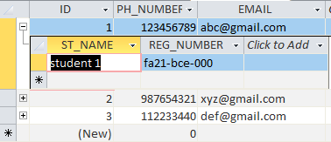
Example

Slide 10
One-to-many relationship
A one-to-many (1:N) relationship in a relational database is a type of relationship between two tables
where each record in the primary (or "one") table can be associated with one or more records in the related (or "many") table.
But each record in the related table is associated with only one record in the primary table.
Lets have a look at the example

Slide 11
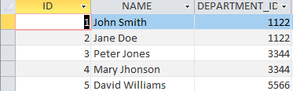
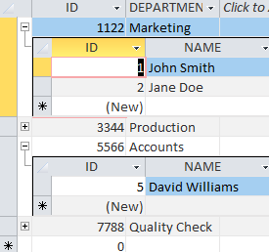

EXAMPLE
In the following example one department can have multiple employees but one employee can have only one department

Slide 12
MANY-TO-MANY RELATIONSHIP
A many-to-many (M:N) relationship in a relational database is a type of relationship between two tables where multiple records in one table can be associated with multiple records in the other table.
This type of relationship requires the use of an intermediary table, often referred to as a junction or link table, to establish the connections.

Slide 13
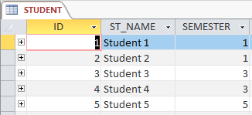
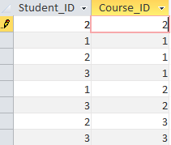

EXAMPLE

Slide 14
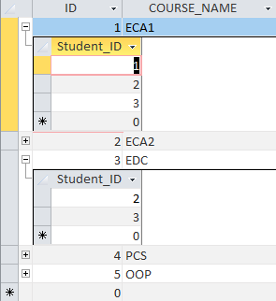
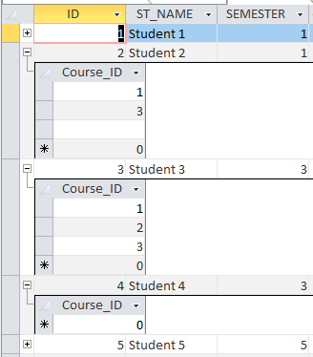
EXAMPLE

Slide 15
CONCLUSION
Forms are the GUI for ease of data entry/manipulation process
Primary key in a unique record in a table
Foreign key is used to establish link between tables
Relationships between tables are essential for database efficiency

Slide 16
THANKS!!!
If there are any queries you may ask

